Slide 1
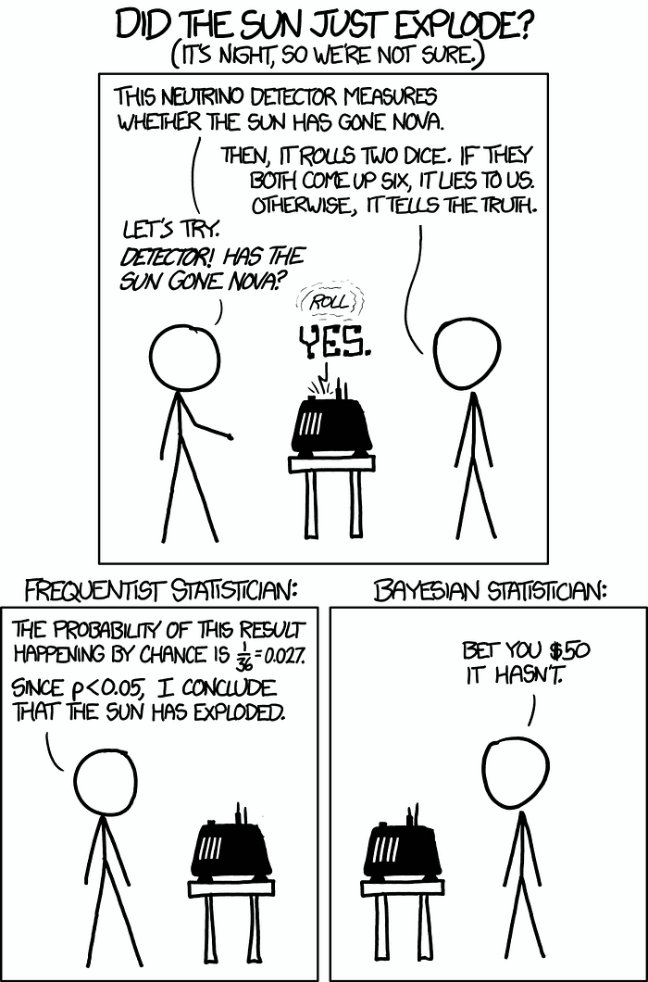
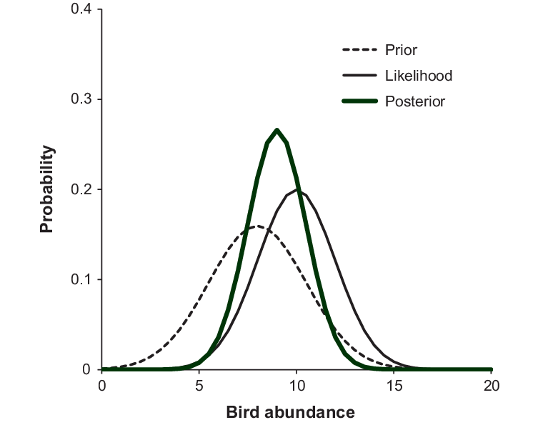
Bayesian statistics and priors

Slide 2
No class next week
Office hours (Stone 307A):
MF 0930-1100
W 1100-1300

Slide 3
We’re going to talk about a LOT of stuff today!
We won’t master it all (I can’t explain it all perfectly off the cuff)
The key idea is to BEGIN to think about how priors and our data interact to inform our final estimate in a Bayesian analysis
These are concepts we’ll revisit over and over again through the semester

Slide 4
Outline
BAYES THEOREM
The technical backbone
STARTING SIMPLE
What is a prior? silly examples!
A back of the envelope wildlife example... beta priors
ADDING COMPLEXITY (also in future weeks)
Key criticisms, and why they lead to problems
Unexpectedly bad priors (Northrup & Gerber, 2018) and philosophy

Slide 5
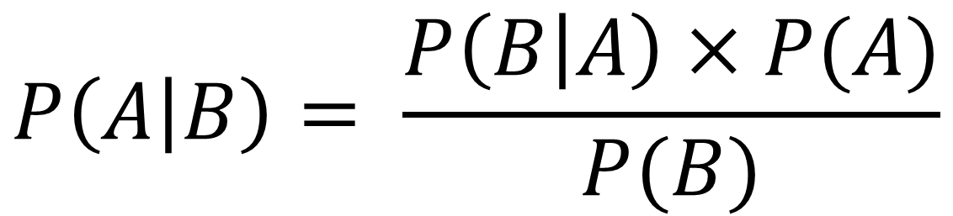
BAYES THEOREM
$$P\left(A | B\right)= \frac{P\left(B | A\right)×P(A)}{P(B)}$$

Slide 6
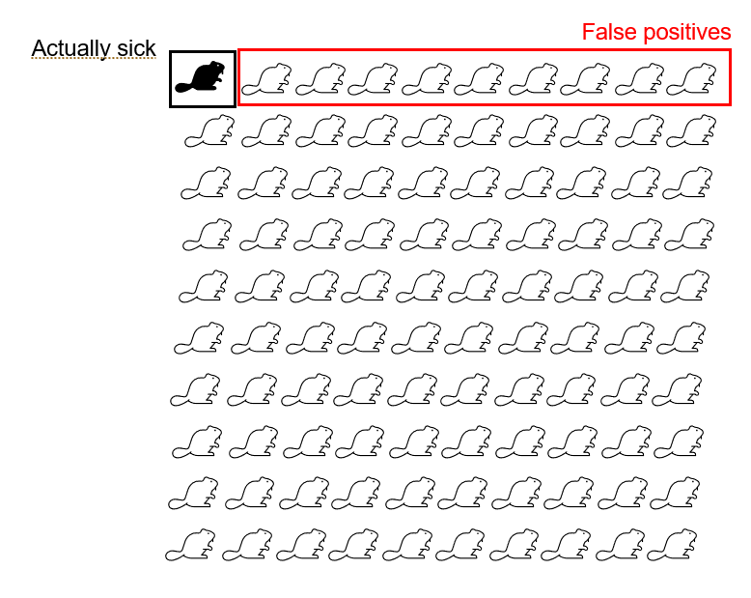
BAYES THEOREM: a quick example from disease ecology
Imagine we test 100 beavers for a disease.
If the disease is present, we observe it (no false negatives!)
There is an 9% false positive rate…

Slide 7
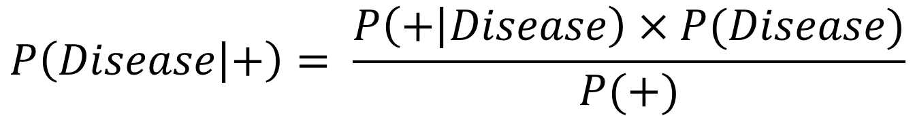
BAYES THEOREM: a quick example from disease ecology
Imagine we test 100 beavers for a disease. 1% of beavers are sick.
If the disease is present, we observe it (no false negatives!)
There is an ~9% false positive rate…
$$P\left(Disease | +\right)= \frac{P\left(+ | Disease\right)×P(Disease)}{P(+)}$$

Slide 8
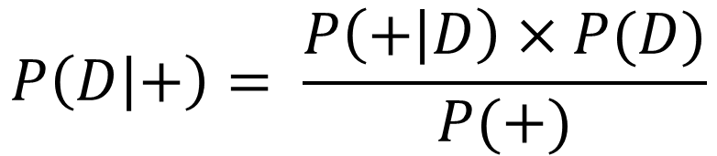
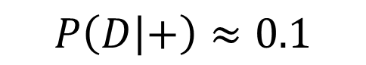
BAYES THEOREM: a quick example from disease ecology
Imagine we test 100 beavers for a disease. 1% of beavers are sick.
If the disease is present, we observe it (no false negatives!)
There is an ~9% false positive rate…
$$P\left(D | +\right)= \frac{P\left(+ | D\right)×P(D)}{P(+)}$$
$$P\left(D | +\right)≈0.1$$

Slide 9
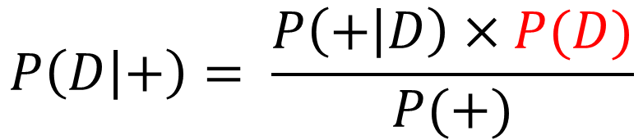
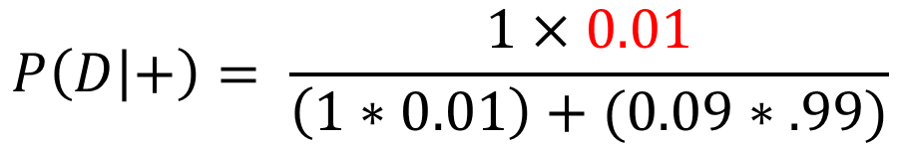
BAYES THEOREM: a quick example from disease ecology
Imagine we test 100 beavers for a disease. 1% of beavers are sick.
If the disease is present, we observe it (no false negatives!)
There is an ~9% false positive rate…
$$P\left(D | +\right)= \frac{P\left(+ | D\right)×P(D)}{P(+)}$$
$$P\left(D | +\right)= \frac{1×0.01}{\left(1∗0.01\right)+(0.09∗.99)}$$
$$P\left(D | +\right)≈0.1$$

Slide 10
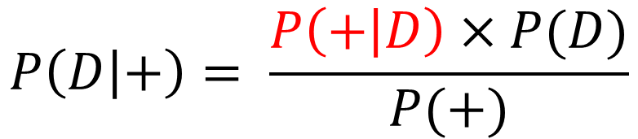
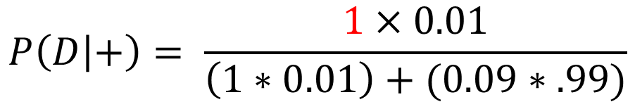
BAYES THEOREM: a quick example from disease ecology
Imagine we test 100 beavers for a disease. 1% of beavers are sick.
If the disease is present, we observe it (no false negatives!)
There is an ~9% false positive rate…
$$P\left(D | +\right)= \frac{P\left(+ | D\right)×P(D)}{P(+)}$$
$$P\left(D | +\right)= \frac{1×0.01}{\left(1∗0.01\right)+(0.09∗.99)}$$
$$P\left(D | +\right)≈0.1$$

Slide 11
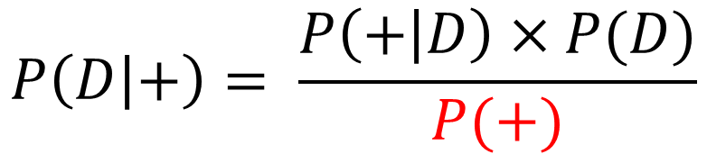
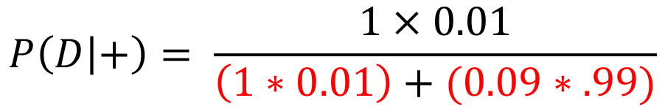
BAYES THEOREM: a quick example from disease ecology
Imagine we test 100 beavers for a disease. 1% of beavers are sick.
If the disease is present, we observe it (no false negatives!)
There is an ~9% false positive rate…
$$P\left(D | +\right)= \frac{P\left(+ | D\right)×P(D)}{P(+)}$$
$$P\left(D | +\right)= \frac{1×0.01}{\left(1∗0.01\right)+(0.09∗.99)}$$
$$P\left(D | +\right)≈0.1$$

Slide 12
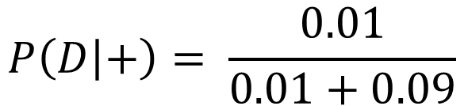
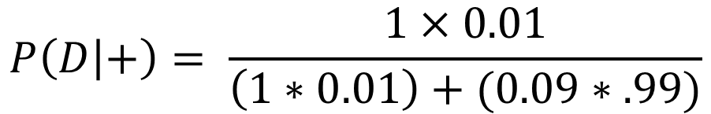
BAYES THEOREM: a quick example from disease ecology
Imagine we test 100 beavers for a disease. 1% of beavers are sick.
If the disease is present, we observe it (no false negatives!)
There is an ~9% false positive rate…
$$P\left(D | +\right)= \frac{P\left(+ | D\right)×P(D)}{P(+)}$$
$$P\left(D | +\right)= \frac{1×0.01}{\left(1∗0.01\right)+(0.09∗.99)}$$
$$P\left(D | +\right)= \frac{0.01}{0.01+0.09}$$
$$P\left(D | +\right)≈0.1$$

Slide 13
BAYES THEOREM: a quick example from disease ecology
Imagine we test 100 beavers for a disease. 1% of beavers are sick.
If the disease is present, we observe it (no false negatives!)
There is an ~9% false positive rate…
$$P\left(D | +\right)= \frac{P\left(+ | D\right)×P(D)}{P(+)}$$
$$P\left(D | +\right)= \frac{1×0.01}{\left(1∗0.01\right)+(0.09∗.99)}$$
$$P\left(D | +\right)= \frac{0.01}{0.01+0.09}$$
$$P\left(D | +\right)≈0.1$$

Slide 14
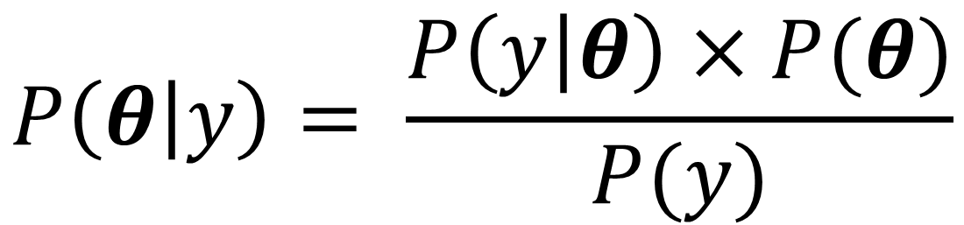
BAYES THEOREM
$$P\left(θ | y\right)= \frac{P\left(y | θ\right)×P(θ)}{P(y)}$$

Slide 15
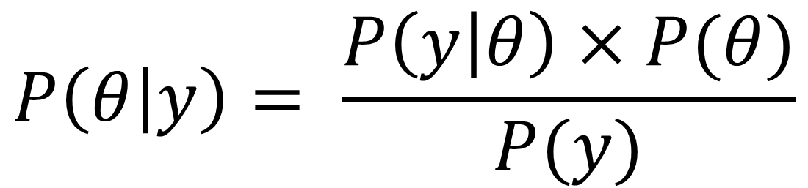
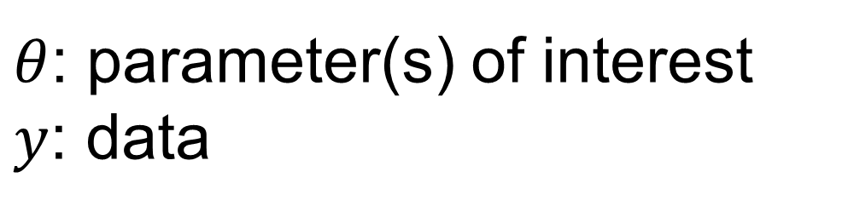
BAYES THEOREM
$$P\left(θ | y\right)= \frac{P\left(y | θ\right)×P(θ)}{P(y)}$$
$θ$: parameter(s) of interest
$y$: data

Slide 16
BAYES THEOREM
Likelihood [these are the estimates you’d get from lm()]
$$P\left(θ | y\right)= \frac{P\left(y | θ\right)×P(θ)}{P(y)}$$
$θ$: parameter(s) of interest
$y$: data

Slide 17
What is a likelihood?
Probability for getting a result for a given value of parameter(s)
Flipping a coin 100 times with 50:50 chance of heads

Slide 18
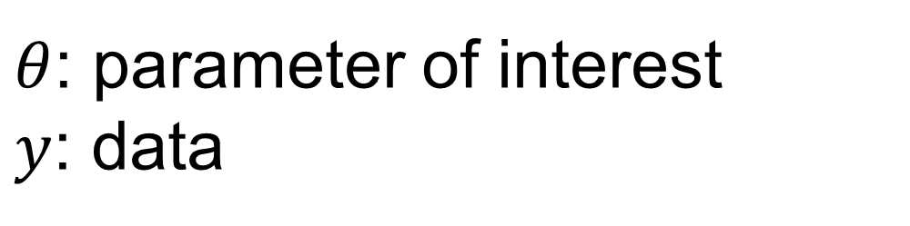
BAYES THEOREM
Likelihood
Prior
$$P\left(θ | y\right)= \frac{P\left(y | θ\right)×P(θ)}{P(y)}$$
$θ$: parameter of interest
$y$: data

Slide 19
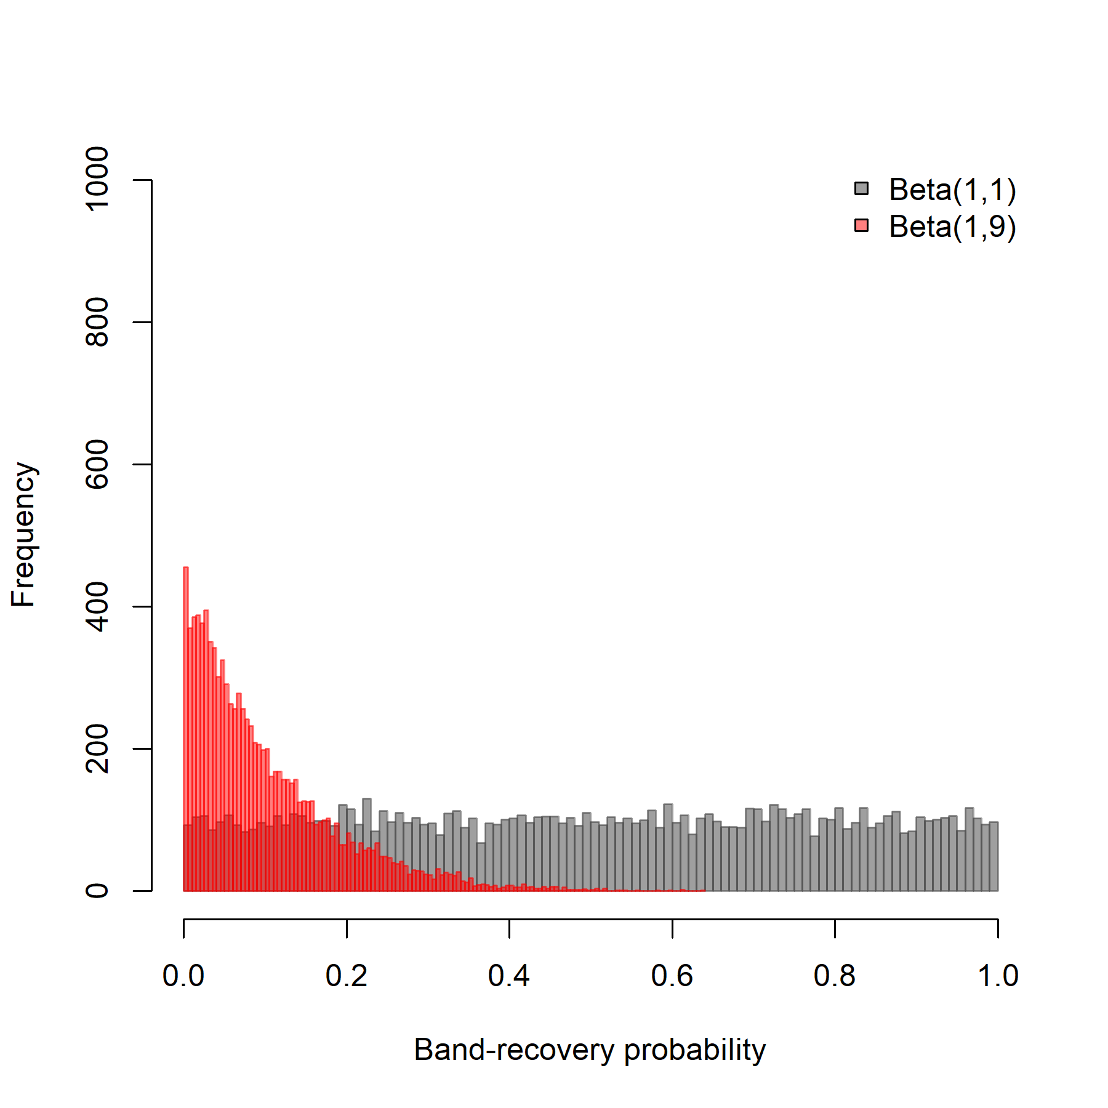
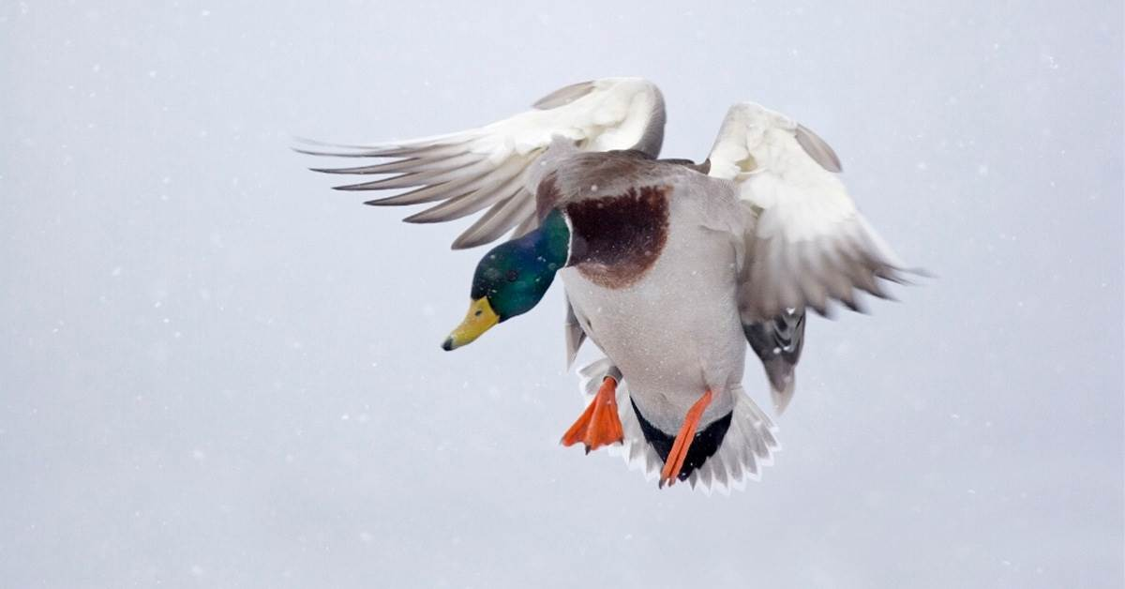
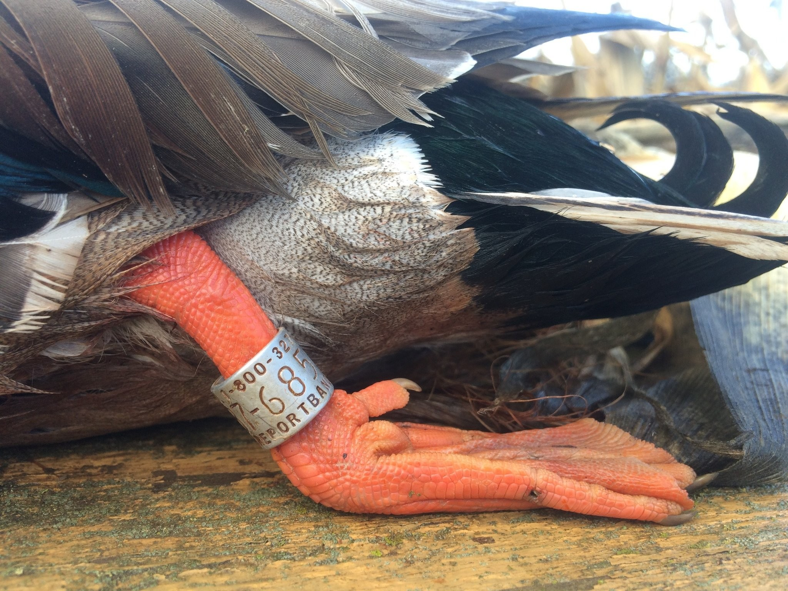
What is a prior?
Your prior belief in the distribution of a parameter.

Slide 20
BAYES THEOREM
Likelihood
Prior
$$P\left(θ | y\right)= \frac{P\left(y | θ\right)×P(θ)}{P(y)}$$
Marginal
$θ$: parameter of interest
$y$: data

Slide 21
What is marginal?
The marginal probability of the data!
i.e., the sum of the probability of the different ways you could observe the data

Slide 22
BAYES THEOREM
Likelihood
Prior
Posterior
$$P\left(θ | y\right)= \frac{P\left(y | θ\right)×P(θ)}{P(y)}$$
Marginal
$θ$: parameter of interest
$y$: data

Slide 23
What is a posterior?
The distribution of a parameter given your prior belief and the data.
Our estimate

Slide 24

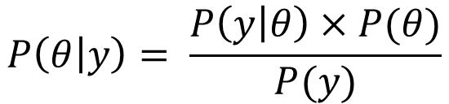
BAYES THEOREM: let’s work through some fun, simple e.g.’s
I saw Bigfoot!
The case of the credulous crackpot
$$P\left(θ | y\right)= \frac{P\left(y | θ\right)×P(θ)}{P(y)}$$

Slide 25
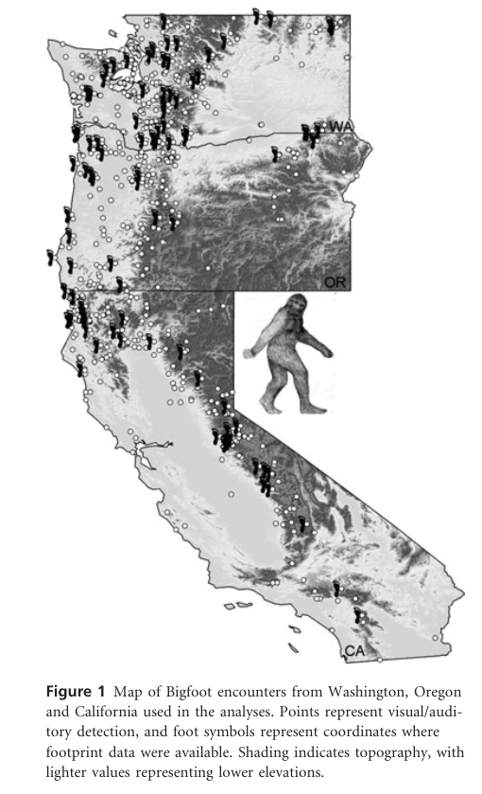
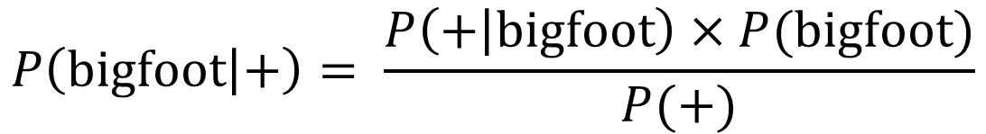
BAYES THEOREM: let’s work through a silly, intuitive example
$$P\left(bigfoot | +\right)= \frac{P\left(+ | bigfoot\right)×P(bigfoot)}{P(+)}$$
$$P\left(θ | y\right)= \frac{P\left(y | θ\right)×P(θ)}{P(y)}$$
Lozier (2009) Journal of Biogeography

Slide 26
BAYES THEOREM: let’s work through a silly, intuitive example
$$P\left(bigfoot | +\right)= \frac{P\left(+ | bigfoot\right)×P(bigfoot)}{P(+)}$$
$$P\left(θ | y\right)= \frac{P\left(y | θ\right)×P(θ)}{P(y)}$$
Lozier (2009) Journal of Biogeography

Slide 27
BAYES THEOREM: let’s work through a silly, intuitive example
Prior
$$P\left(bigfoot | +\right)= \frac{P\left(+ | bigfoot\right)×P(bigfoot)}{P(+)}$$
Prior: the probability of an event pre-data
$$P\left(θ | y\right)= \frac{P\left(y | θ\right)×P(θ)}{P(y)}$$
Lozier (2009) Journal of Biogeography

Slide 28
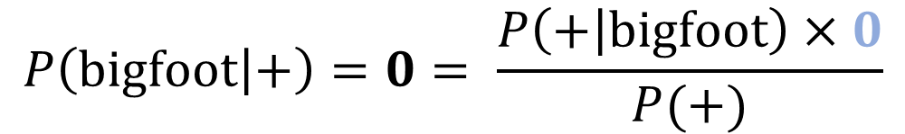
BAYES THEOREM: let’s work through a silly, intuitive example
$$P\left(bigfoot | +\right)=0= \frac{P\left(+ | bigfoot\right)×0}{P(+)}$$
Bigfoot does not exist, zero divided by whatever = 0… analysis complete
$$P\left(θ | y\right)= \frac{P\left(y | θ\right)×P(θ)}{P(y)}$$

Slide 29
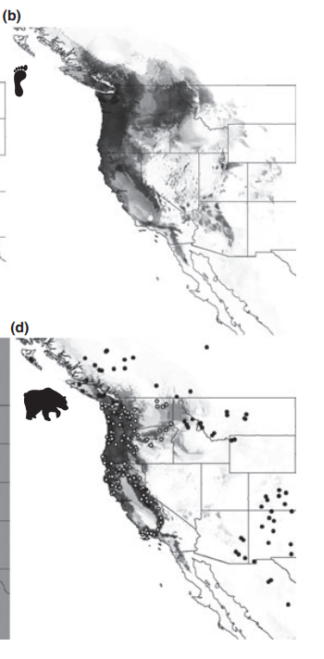
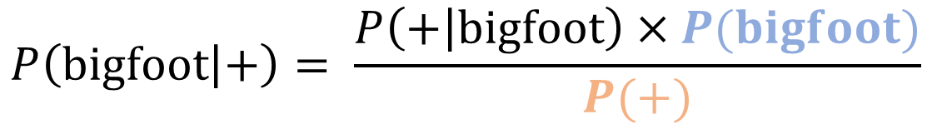
BAYES THEOREM: what about the marginal?
$$P\left(bigfoot | +\right)= \frac{P\left(+ | bigfoot\right)×P(bigfoot)}{P(+)}$$
$$P\left(θ | y\right)= \frac{P\left(y | θ\right)×P(θ)}{P(y)}$$
Lozier (2009) Journal of Biogeography

Slide 30
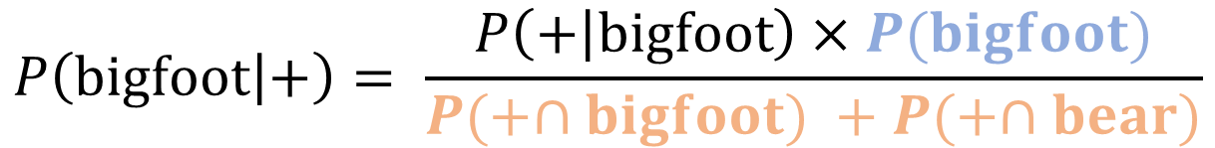
BAYES THEOREM: what about the marginal?
$$P\left(bigfoot | +\right)= \frac{P\left(+ | bigfoot\right)×P(bigfoot)}{P(+∩bigfoot) +P(+∩bear)}$$
$$P\left(θ | y\right)= \frac{P\left(y | θ\right)×P(θ)}{P(y)}$$
Lozier (2009) Journal of Biogeography

Slide 31
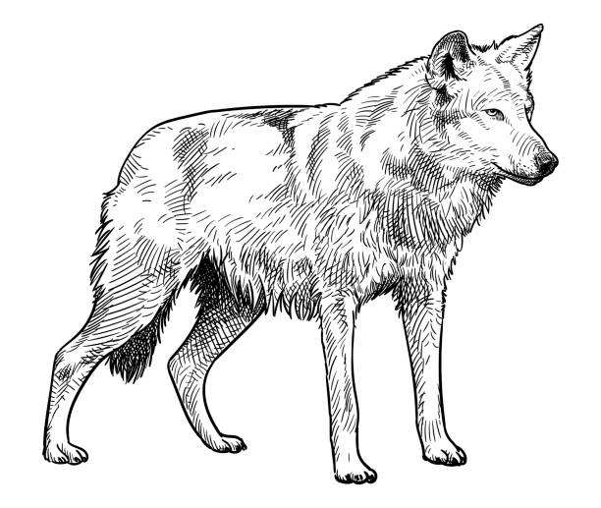

The credulous crackpot strikes again!
I saw a wolf!
$$P\left(θ | y\right)= \frac{P\left(y | θ\right)×P(θ)}{P(y)}$$

Slide 32
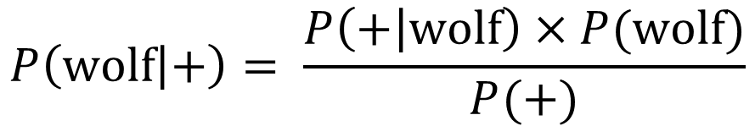
BAYES THEOREM: let’s work through a better example
$$P\left(wolf | +\right)= \frac{P\left(+ | wolf\right)×P(wolf)}{P(+)}$$
Lozier (2009) Journal of Biogeography

Slide 33
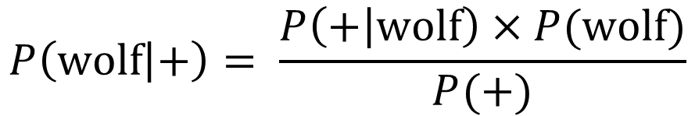
BAYES THEOREM: let’s work through a better example
Prior
$$P\left(wolf | +\right)= \frac{P\left(+ | wolf\right)×P(wolf)}{P(+)}$$
Marginal

Slide 34
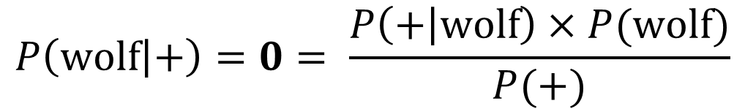
BAYES THEOREM: let’s work through a better example
Prior
$$P\left(wolf | +\right)=0= \frac{P\left(+ | wolf\right)×P(wolf)}{P(+)}$$
Marginal
Prior: probability of the event
Marginal: the probability of the data…

Slide 35
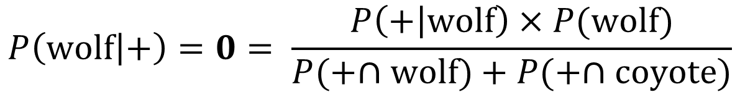
BAYES THEOREM: let’s make some assumptions
Prior
$$P\left(wolf | +\right)=0= \frac{P\left(+ | wolf\right)×P(wolf)}{P(+∩wolf)+P(+∩coyote)}$$
Marginal
We’ll assume they actually saw a large wild canid (i.e., either coyote or wolf)

Slide 36
BAYES THEOREM: let’s make some assumptions
Prior
$$P\left(wolf | +\right)=0= \frac{P\left(+ | wolf\right)×P(wolf)}{P(+∩wolf)+P(+∩coyote)}$$
Marginal
Prior: let’s imagine a 2:1 coyote:wolf ratio
Marginal: if wolf, wolf, if coyote, 50:50

Slide 37
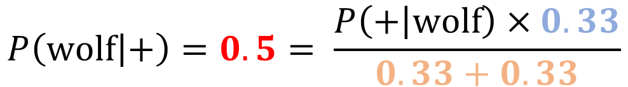
BAYES THEOREM: let’s make some assumptions
Prior
$$P\left(wolf | +\right)=0.5= \frac{P\left(+ | wolf\right)×0.33}{0.33+0.33}$$
Marginal
Prior: let’s imagine a 2:1 coyote:wolf ratio
Marginal: if wolf -> wolf, if coyote, 50:50

Slide 38
BAYES THEOREM: let’s make some assumptions
Prior
Wolf
$$P\left(wolf | +\right)=0.5= \frac{P\left(+ | wolf\right)×0.33}{0.33+0.33}$$
Marginal
Prior: let’s imagine a 2:1 coyote:wolf ratio
Misidentified as wolf (coyote)
Marginal: if wolf -> wolf, if coyote, 50:50
Coyote

Slide 39
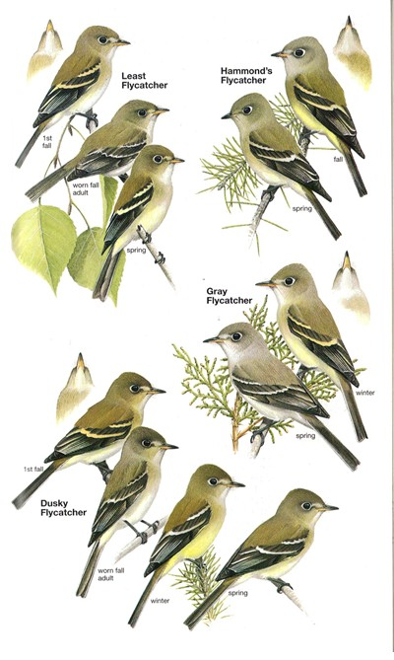
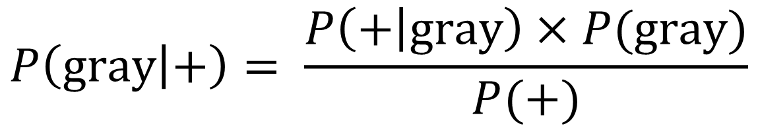
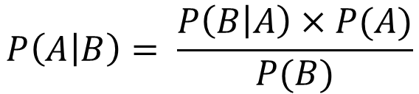
BAYES THEOREM: a complex/realistic example (Empid. ppp.)
$$P\left(gray | +\right)= \frac{P\left(+ | gray\right)×P(gray)}{P(+)}$$
$$P\left(A | B\right)= \frac{P\left(B | A\right)×P(A)}{P(B)}$$

Slide 40
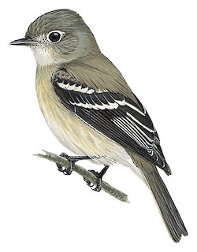
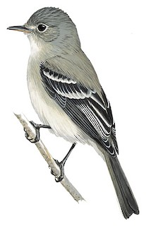
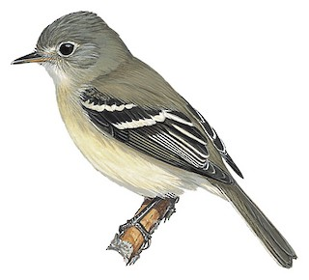
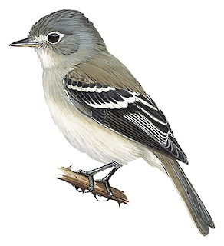
Hammond’s
Gray
Dusky
Least

Slide 41
I’m kidding, we’re not making up that many numbers

Slide 42
There are three key points here:
The math works.

Slide 43
There are three key points here:
The math works.
This is how ‘we’ naturally think about things! We routinely (i.e., all the freaking time) use prior information!

Slide 44
There are three key points here:
The math works.
This is how ‘we’ naturally think about things! We routinely use prior information!
We’re using fixed (known) values. This starts to get really complicated with uncertainty (we’re going to need help from JAGS and Stan)!

Slide 45
A huge non-Bayesian fear is that priors affect posteriors (inference)
The distribution of a parameter given your prior belief and the data.
How humans learn might not be the way to go ☺

Slide 46
A huge non-Bayesian fear is that priors affect posteriors (inference)
Priors do affect posteriors, this is not an irrational fear

Slide 47
BAYES THEOREM: a response to a (the?) key criticism
We’ll use ‘uninformative’ priors for everything. These priors will not affect our inference.
Then you can’t criticize us!

Slide 48
BAYES THEOREM: a response to a (the?) key criticism
We’ll use ‘uninformative’ priors for everything. These priors will not affect our inference.
Then you can’t criticize us!
This was a key mistake, and honestly it’s kind of bizarre

Slide 49
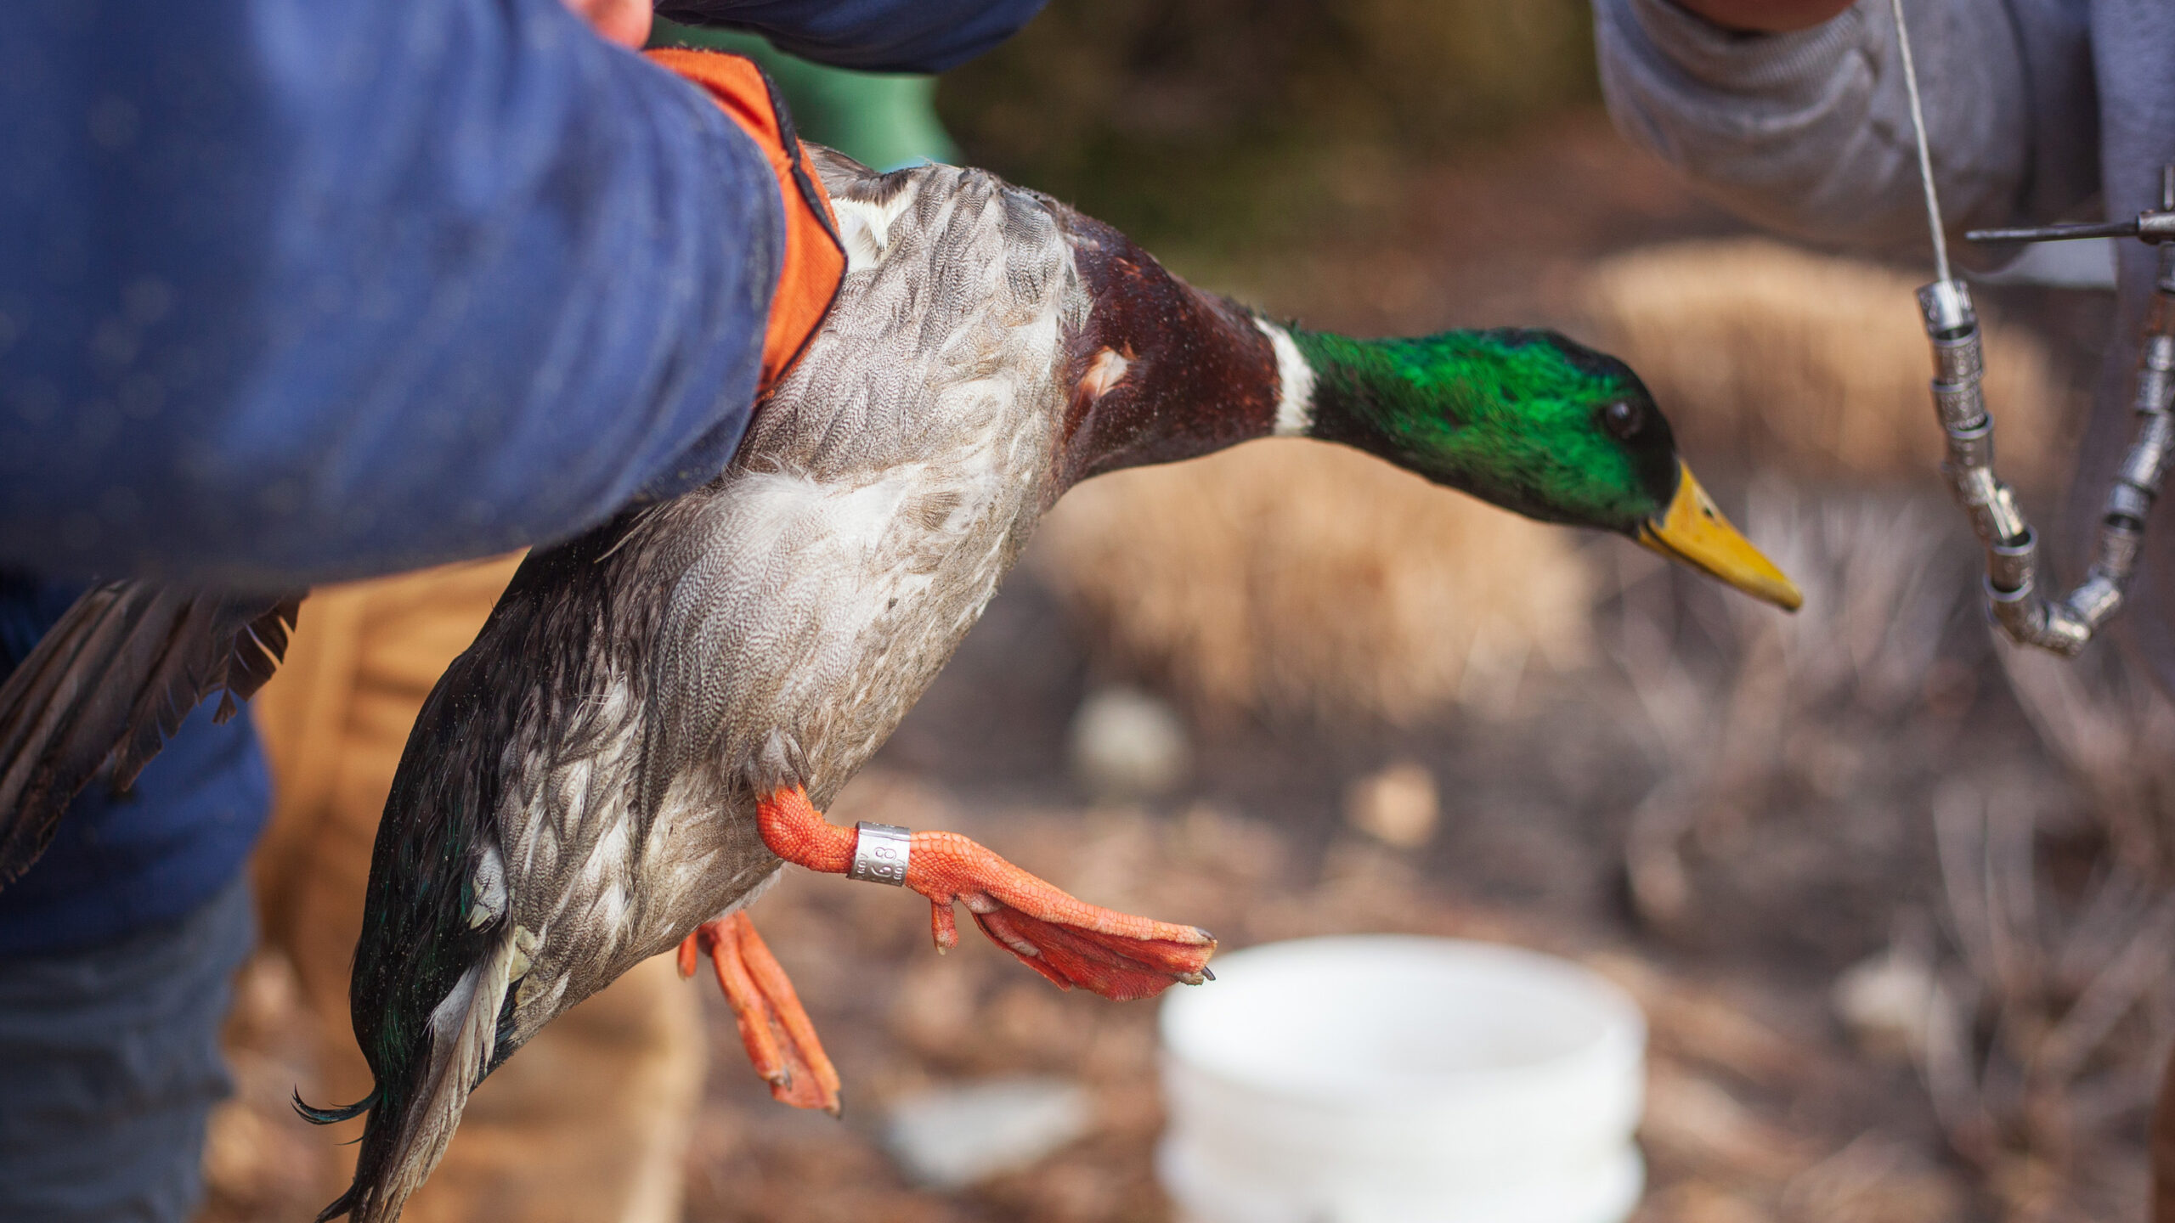
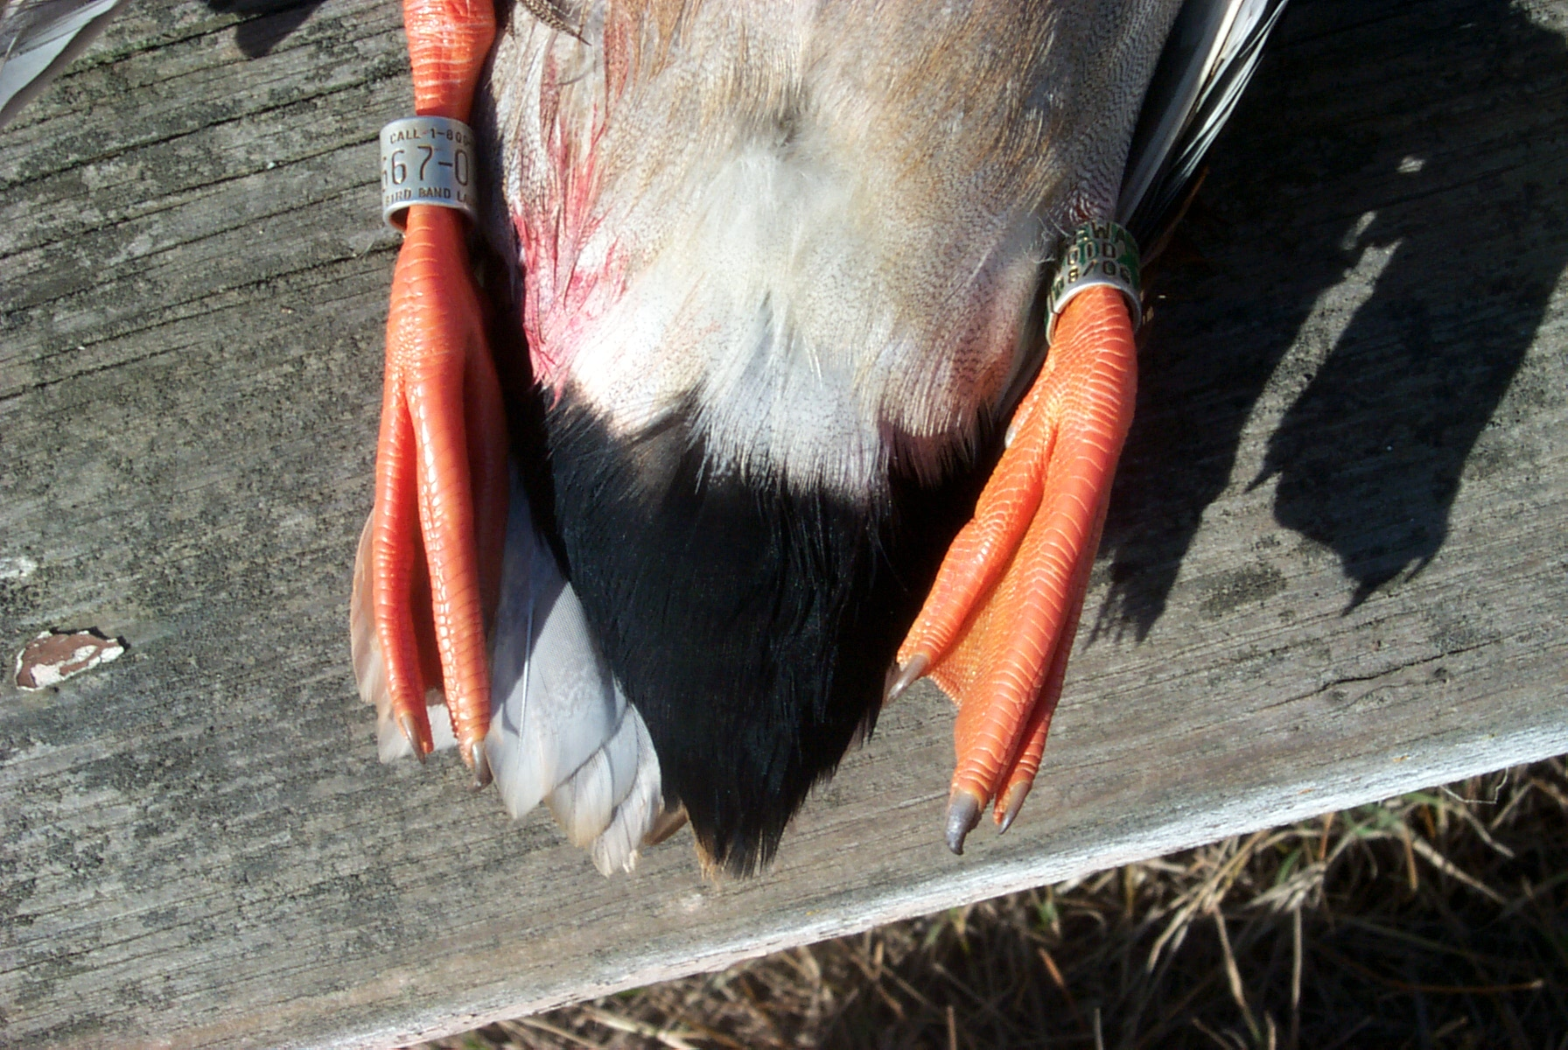
‘Uninformative*’ priors
*Priors are never ‘uninformative.’

Slide 50
If you disagree…
Then describe a prior without providing any information.

Slide 51
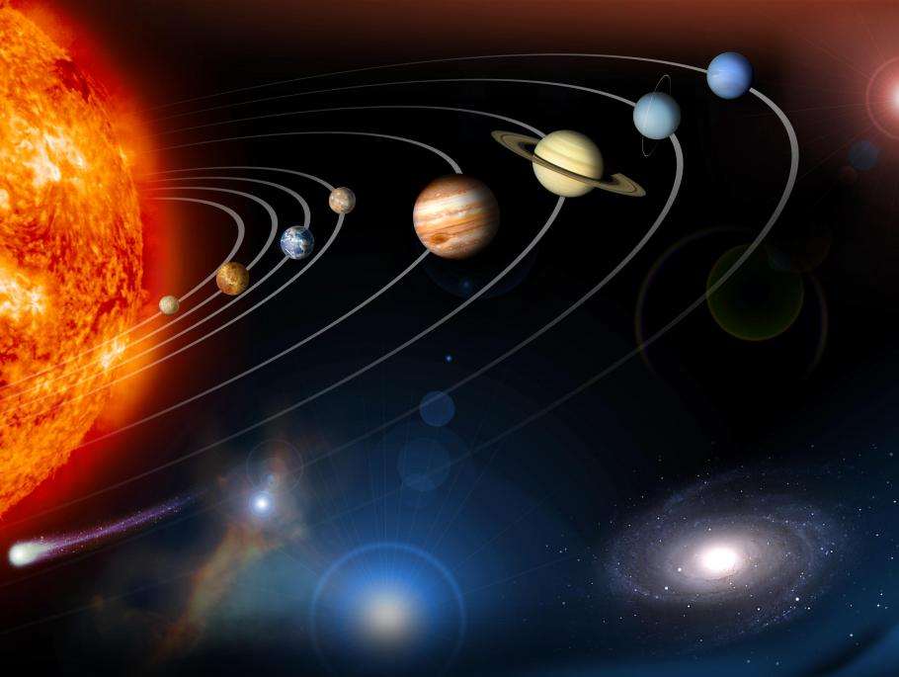
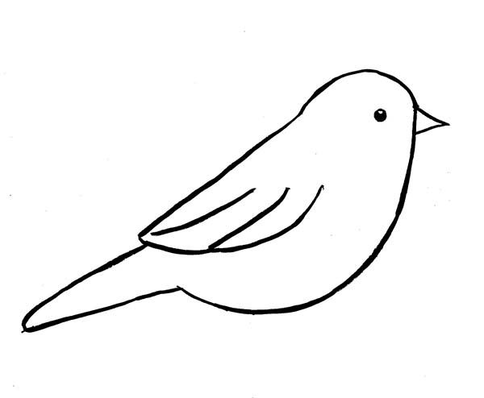
Sometimes priors are way too ‘uninformed’

Slide 52

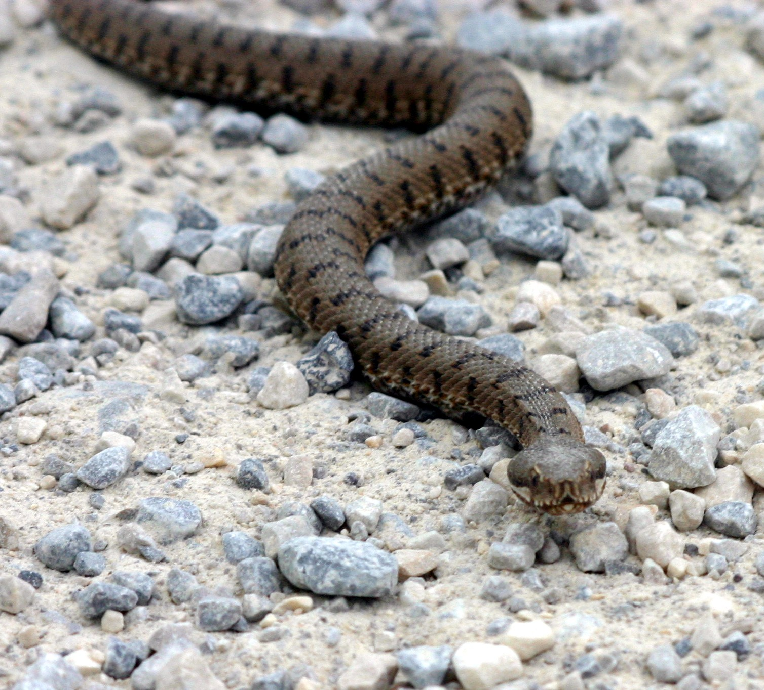

Sometimes priors are waaaay too ‘uninformed’
Earth’s diameter is 12,756 km

Slide 53
Starting simple: what should our goal be with a prior?
How tall is a man you’ve never met before?

Slide 54
An example: how tall is a man you’ve never met before?
5’ 10 ⅞” ± ⅓”
Normal(μ = 70.875, σ = 0.1)
‘Very informative’

Slide 55
An example: how tall is a man you’ve never met before?
Equally likely that they’re between 2’ and 10’ tall
Uniform(24, 120)
‘Uninformative’

Slide 56
An example: how tall is a man you’ve never met before?
5’ 10” ± 12”
Normal(μ = 70, σ = 3)
‘Biologically reasonable!’

Slide 57
An example: how tall is a man you’ve never met before?
‘Please stop talking to me.’
Also an acceptable answer.

Slide 58
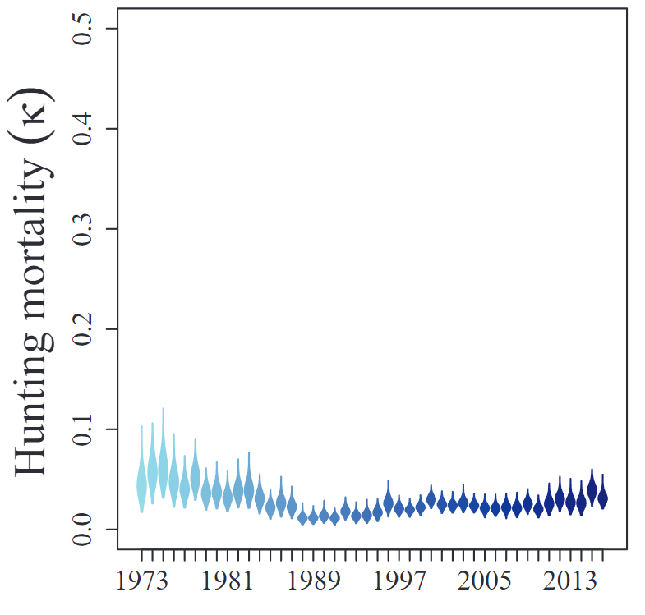
Our goal: ‘Biologically informative’ or ‘reasonably vague’ priors
What is the band-recovery probability for adult female blue-winged teal?

Slide 59
Our goal: ‘Biologically informative’ or ‘reasonably vague’ priors
What if you knew a change to hunting regulations was coming that might increase harvest above historic levels?

Slide 60
Our goal: ‘Biologically informative’ or ‘reasonably vague’ priors
What is the band-recovery probability for adult female blue-winged teal?

Slide 61
Prior ‘guidelines’
Your prior should be based on the literature or existing knowledge if possible

Slide 62
Prior ‘guidelines’
Your prior should be based on the literature or existing knowledge if possible
It should be vague enough not to drive the analysis (e.g., prior-posterior overlap)

Slide 63
Prior ‘guidelines’
Your prior should be based on the literature or existing knowledge if possible
It should be vague enough not to drive the analysis (e.g., prior-posterior overlap)
You should not a priori believe in impossible values (i.e., priors can be too ‘uninformative’).

Slide 64
Prior ‘guidelines’
Your prior should be based on the literature or existing knowledge if possible
It should be vague enough not to drive the analysis (e.g., prior-posterior overlap)
You should not a priori believe in impossible values (i.e., priors can be too ‘uninformative’)
*I recognize that this is incredibly subjective!

Slide 65
Let’s actually do something!

Slide 66
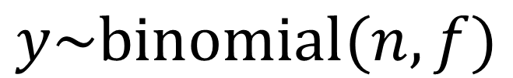
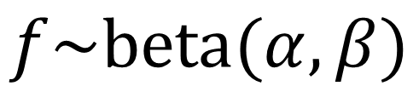
Beta-binomial models: our first Bayesian analysis
$$y\sim binomial(n, f)$$
$$f\sim beta(α, β)$$

Slide 67

Beta-binomial models: our first Bayesian analysis
$$y\sim binomial(n, f)$$
$$f\sim beta(α, β)$$
n: number of marked and released adult male mallards

Slide 68

The binomial distribution
$$y\sim binomial(n, f)$$
$$f\sim beta(α, β)$$
y: the number of recoveries of banded adult male mallards

Slide 69


Beta-binomial models: our first Bayesian analysis
$$y\sim binomial(n, f)$$
$$f\sim beta(α, β)$$
f: band-recovery probability (the parameter we want to estimate!)

Slide 70



The binomial distribution (and Bernoulli trials)
$$y\sim Bernoulli(0.5)$$
$$y\sim binomial(100, 0.5)$$

Slide 71




The binomial distribution (flipping coins)
$$y\sim binomial(n, p)$$
$$y\sim binomial(100, 0.5)$$
$$E(y)\sim n×p$$
$$V(y)\sim n×p×(1−p)$$

Slide 72


The binomial distribution
$$y\sim binomial(n, p)$$
$$y\sim binomial(40, 0.5)$$
$$E(y)\sim n×p$$
$$V(y)\sim n×p×(1−p)$$

Slide 73

The beta distribution
$$y\sim binomial(n, f)$$
$$f\sim beta(α, β)$$

Slide 74


The beta distribution as a conjugate prior for the binomial dist.
Number of flips/games
Number of heads/wins
Prob. of heads/win
$$y\sim binomial(n, p)$$
$$p\sim beta(α, β)$$
Prior for number of tails/losses
Prior for number of heads/wins

Slide 75


Conjugacy!*
$$y\sim binomial(n, f)$$
$$f\sim beta(α, β)$$

Slide 76



We can do this by hand!!
Data model
$$y\sim binomial(n, f)$$
$$f\sim beta(α, β)$$
Prior
$$\hat{f}\sim beta(α+y, β+(n−y))$$
Posterior

Slide 77

A quick example
Data model
$$y\sim binomial(n, f)$$
$$f\sim beta(α, β)$$
Prior
$$\hat{f}\sim beta(α+y, β+(n−y))$$
Posterior

Slide 78





A quick example
$$y\sim binomial(n, f)$$
$$137\sim binomial(1000, f)$$
Data
$$f\sim beta(1, 1)$$
Prior
$$\hat{f}\sim beta(1+137, 1+(863))$$
Posterior
$$\hat{f}\sim beta(α+y, β+(n−y))$$

Slide 79



A quick example
$$137\sim binomial(1000, f)$$
$$f\sim beta(1, 1)$$
$$\hat{f}\sim beta(138, 864)$$

Slide 80


Playing with fire…
Weak (uniform b/w 0 and 1)
$$f\sim beta(1, 1)$$
Moderate
$$f\sim beta(1, 9)$$
Strong
$$f\sim beta(5, 95)$$
Let’s try this again with some more substantial prior information

Slide 81
We just generated posterior distributions!
They are vectors of length 10000 (samples)
They contain means, medians, and CREDIBLE intervals
We can extract those with simple R functions (Lines 80-85)

Slide 82
So what happened (Lines 88-97)?

Slide 83
We have strong data (and excellent prior knowledge)!
We marked 1000 ducks! The means vary by hundredths of 1 percent

Slide 84
What if we REALLY had strong prior knowledge
Let’s assumed we’re convinced we’ll shoot 50 out of 1000 teal
Try beta(50,950) as a ‘strong’ prior

Slide 85
What if our prior knowledge was bad?
Let’s assume we’re convinced that 7%, or 7 out of 100, of teal get shot!
Try beta(7,93) as a ‘strong’ prior

Slide 86
What if our prior knowledge was bad?
Let’s assume we’re convinced that 7%, or 7 out of 100, of teal get shot!
Try beta(70,930) as a ‘strong’ prior

Slide 87
Moment-matching?!
Imagine that we have an estimate of average teal band-recovery probability. It’s reported in a manuscript as 0.0487 (sd = 0.01).
How would we use that in a beta prior?

Slide 88


Moment-matching?!
If we have an estimate with μ=0.0487 and σ=0.01
$$α=\left(\frac{1−μ}{σ^{2}}−\frac{1}{μ}\right)μ^{2}$$
$$β=α\left(\frac{1}{μ}−1\right)$$

Slide 89


Moment-matching?!
If we have an estimate with μ=0.0487 and σ=0.01
$$α=\left(\frac{1−μ}{σ^{2}}−\frac{1}{μ}\right)μ^{2}$$
$$β=α\left(\frac{1}{μ}−1\right)$$

Slide 90
Wrapping up…
P(sun explosion) = 0.00000000000…000001
$$P\left(sun explosion | YES\right)= \frac{P\left(+ | sun explosion\right)×P(sun explosion)}{P(+)}$$

Slide 91
Key take-home: Priors are just that, our prior belief

Slide 92
Key take-home: they are subjective, and cannot be uninformative

Slide 93
Key take-home: strong priors can save us from ‘bad’ data!

Slide 94
Key take-home: they can also hide real signals in data!
Imagine you were convinced the right prior for our duck harvest example was beta(500,500)

Slide 95
Key take-home: we can perform prior sensitivity analyses!!!
If our prior sensitivity analyses reveal little difference in inference between extremely vague and extremely informative priors, then our conclusions may be robust (given our model assumptions).

Slide 96
Summary of summaries:
Priors are just that, our prior belief. They are ‘objectively subjective’, cannot be uninformative, and should be carefully thought about based upon existing knowledge*
Strong priors can save us from ‘bad’ data, or they can hide real signals in data!
Prior sensitivity analysis can allow us to determine how much the strength of our beliefs impacts inference
*sorry to be a grumpy old man here! This is important!

Slide 97
Reading
https://github.com/thomasriecke/ST595

